Slide 1

Traffic Pattern Analysis and Prediction
Analyzing and predicting traffic patterns to improve management and reduce congestion.
Project by : - Rohan Tekale
Shivang Thigale

Slide 2

Business Problem
"Analyzing and Predicting Traffic Patterns”
A Data-Driven Approach (Nov 2015 - June 2017)

Slide 3
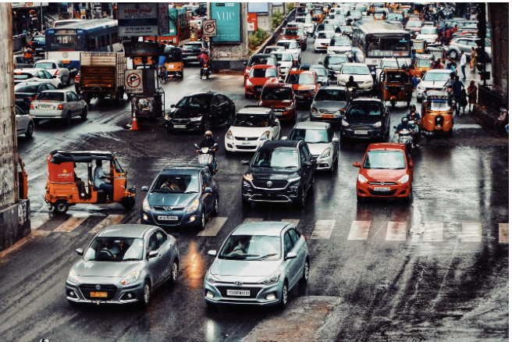
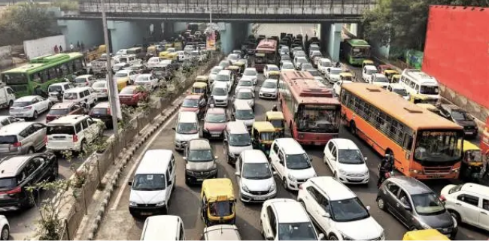
Business Problem (Continued)
Goal: Improve traffic management, reduce congestion, and enhance road safety.

Slide 4

What We Have Done
Collected data, performed EDA, engineered features, trained models.

Slide 5
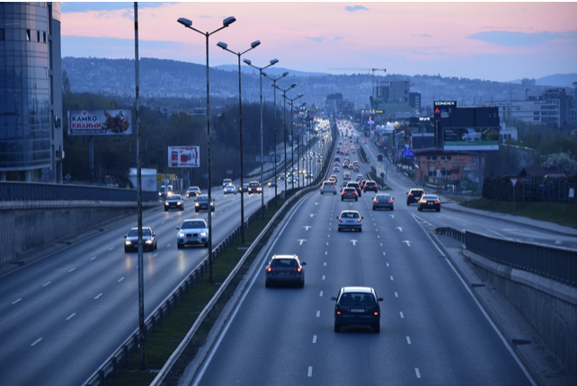
How It Helps
Improves traffic flow, reduces delays, enhances safety.

Slide 6

Efficient Traffic Management
Optimized Traffic flow
Safety Improvements
Accident Prevention
Emergency Response
Environmental Benefits
Reduced Emissions
Sustainable Urban Planning
Incident Management

Slide 7


Why We Use It
Data-driven decisions for efficient traffic management.

Slide 8




Tech Stack and Algorithms
Python, Pandas, Scikit-learn, Random Forest, Gradient Boosting, XGBoost.

Slide 9
Analysis Flow Chart
Project Setup
EDA
Model Training
Visualization
Data Preprocessing
Feature Engineering
Model Evaluation

Slide 10
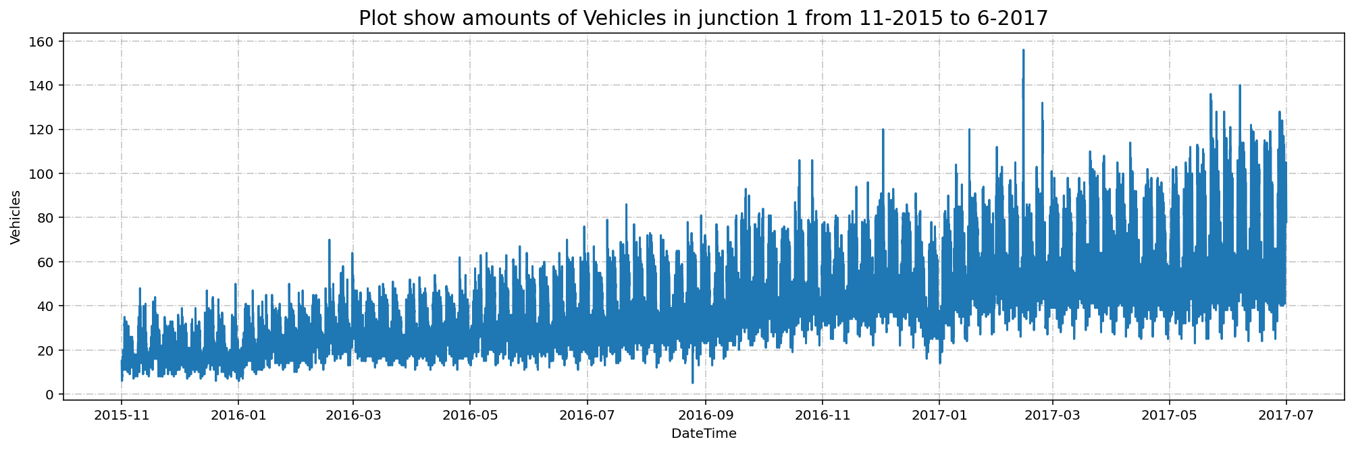
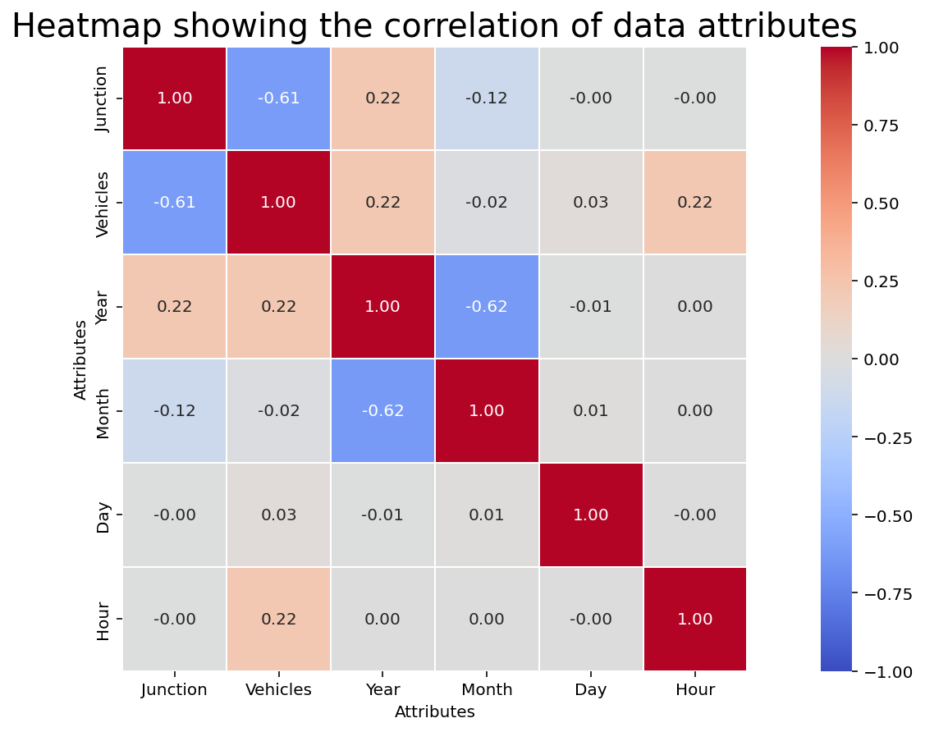
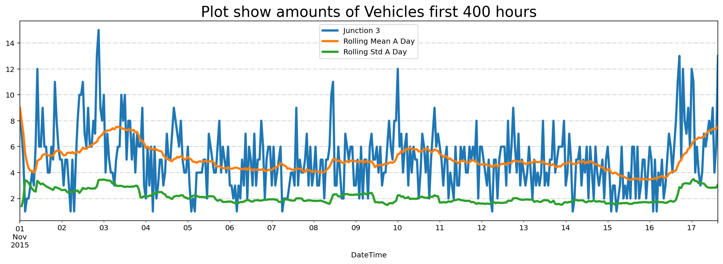
Exploratory Data Analysis (EDA)

Slide 11
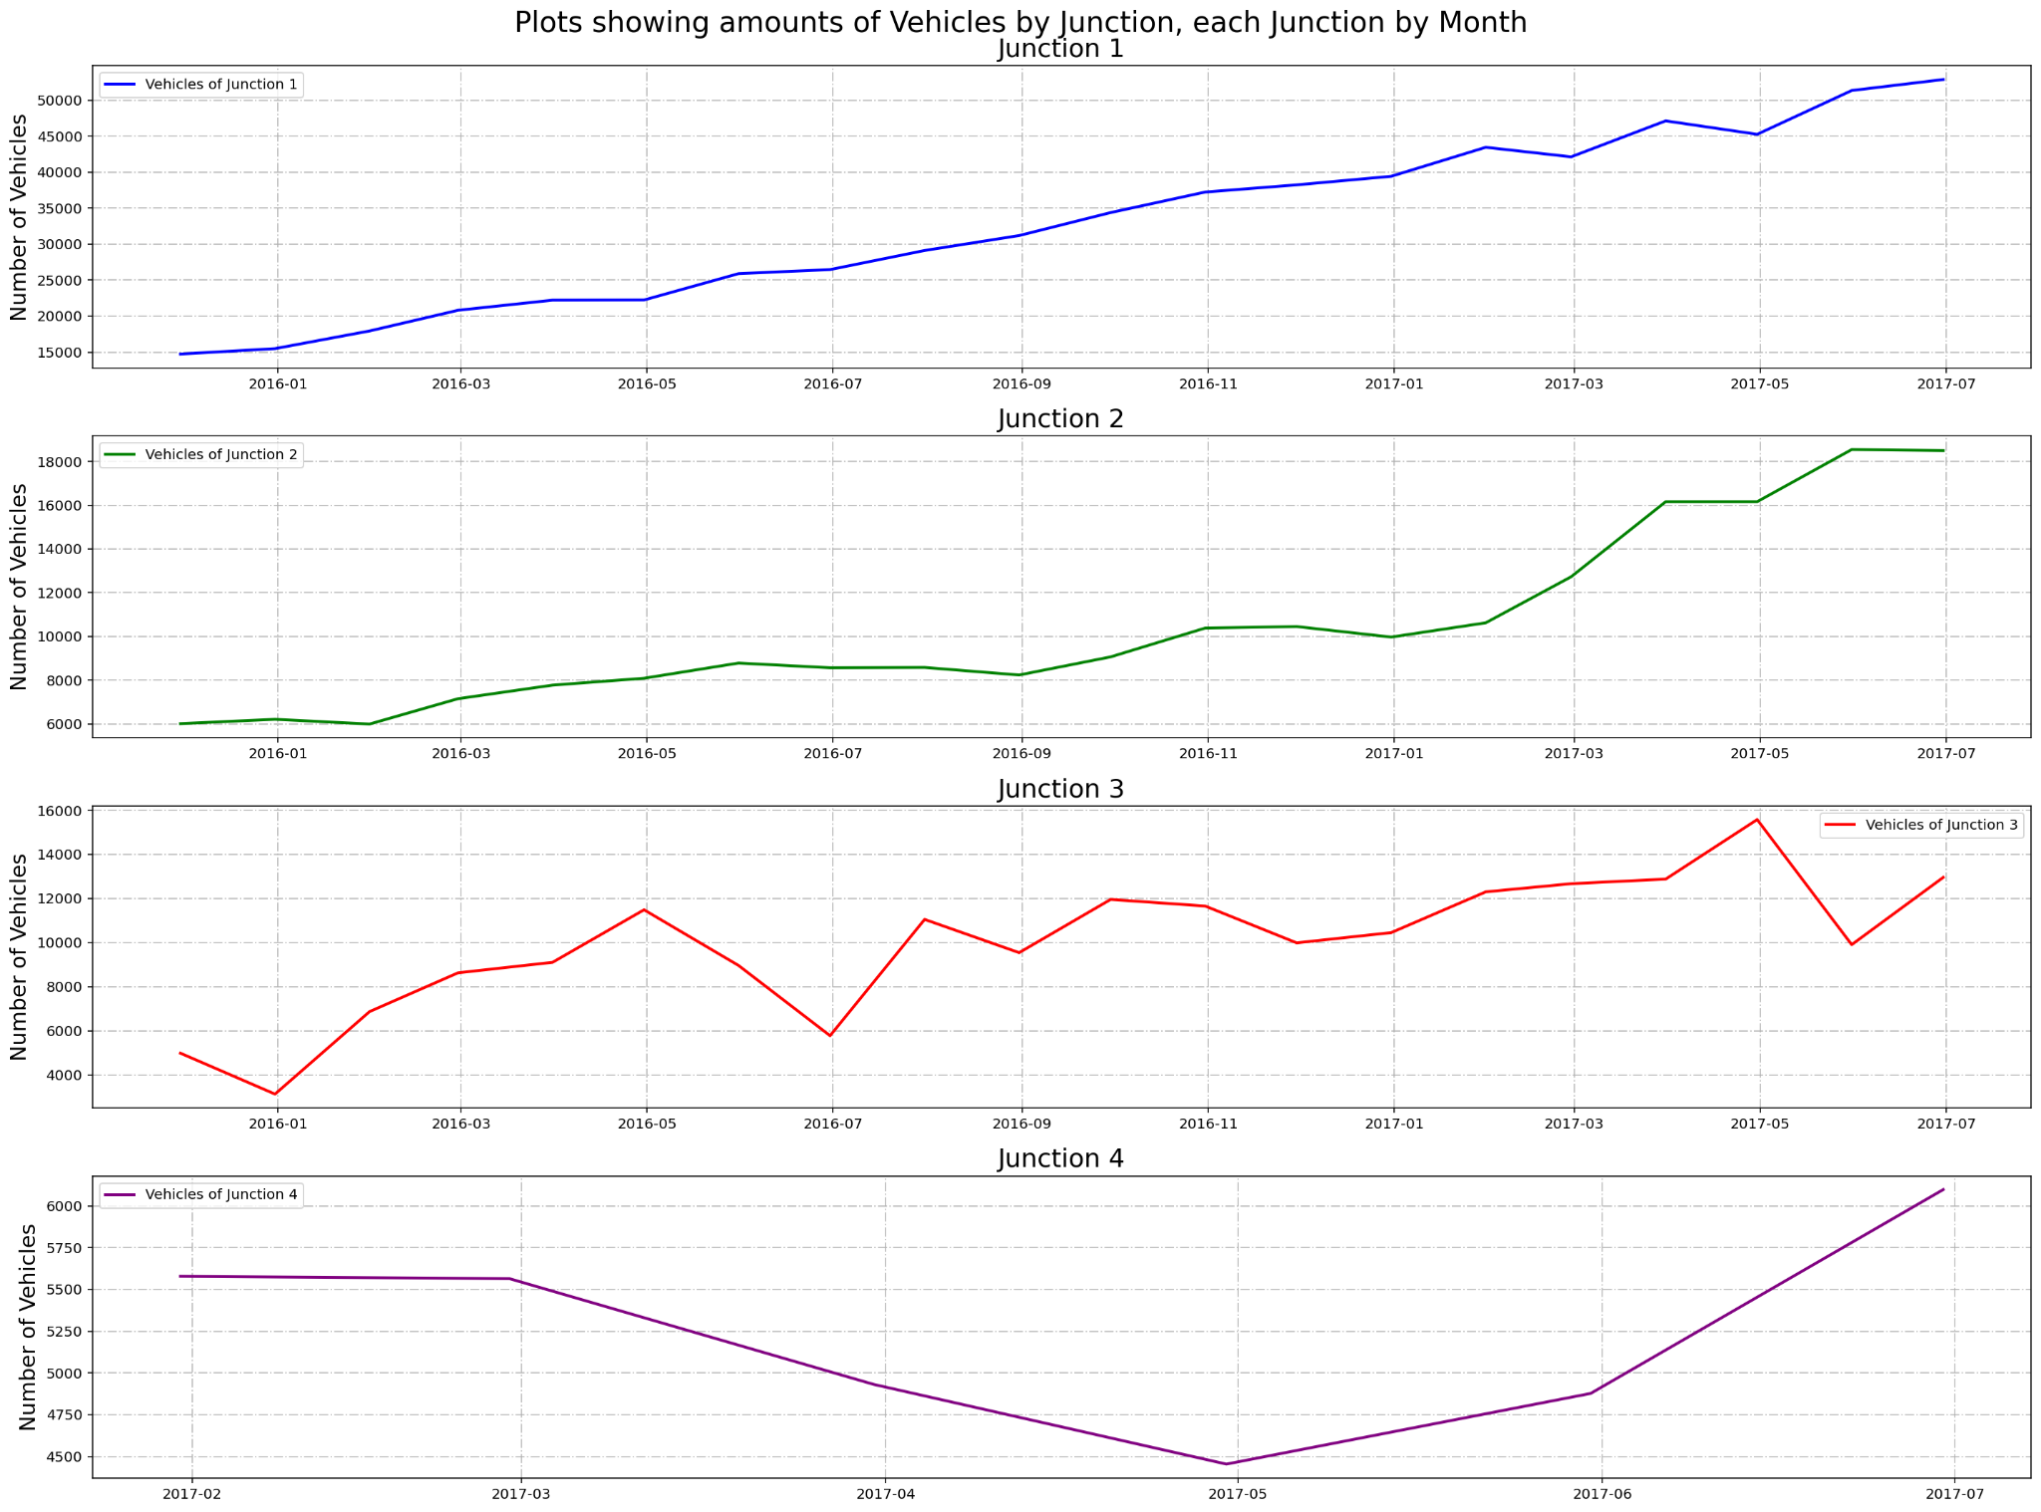
Exploratory Data Analysis (EDA) (Continued)

Slide 12
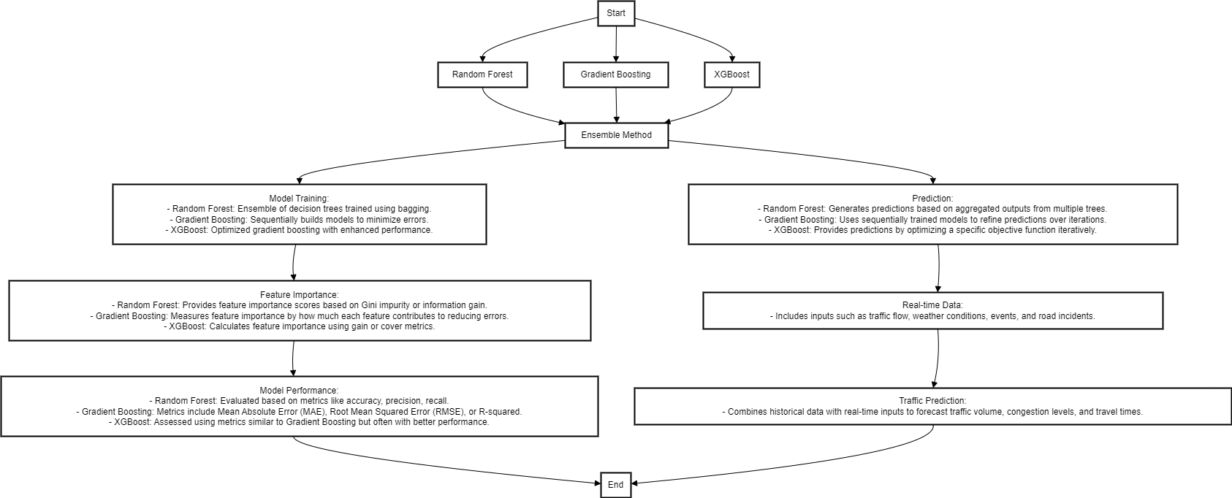
Model Comparison
Comparison of models based on accuracy, precision, recall.

Slide 13
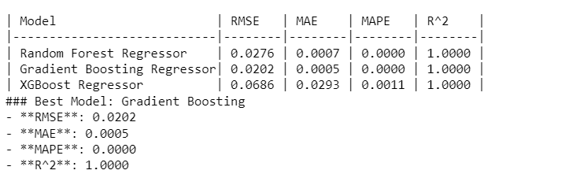
Results and Accuracy
Different Models results with accuracy scores

Slide 14
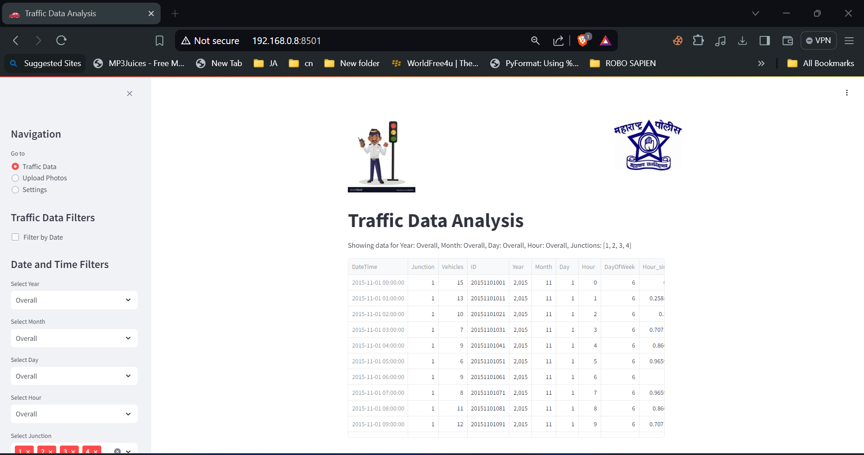
User Interface
Overview of the user interface for monitoring traffic patterns.

Slide 15


